Slide 1
DATA SCIENCE Project Proposal
Here is where your presentation begins

Slide 2
TABLE OF CONTENTS
01
04
02
05
03
06
About the Data
Sneak peek
Cyclistic Bike Company,Divvy Data source
We visualized the Data using Tableau and Excel
Establish the Data
Decision making
We prepared the data according to the requirement
Digital marketing,viability,
Go-to-Market (GTM) Strategy
Transformation of Data
Portfolio
All the necessary details of the project are uploaded here.
We used the tools R,Excel and SQL to clean,transform and view the data

Slide 3
01
About the Data
Industry Focus: Marketing, Lead generation

Slide 4
How many casual bike riders can be converted to annual members.
Gathered Cyclist Bike data from Divvy website.
Past 12 month Data from Feb 2022 till Jan 2023 sourced.
Data contained two types of bike riders: Casual and Annual

Slide 5
02
Establish the Data
We loaded the Data into R and worked on it.

Slide 6
We first extract data to data frame in R
And we perform various operations to transform the data
Then we load the results into Excel sheet to summarize our data(ETL)
This whole process followed ETL

Slide 7
03
Establish the Data
We loaded the Data into R and worked on it.

Slide 8
Transformation of data involved several tools like R and SQL
We observed the trends followed by the casual bike riders which was not present in the original data.

Slide 9
04
Sneak peek
We loaded the Data into R and worked on it.

Slide 10
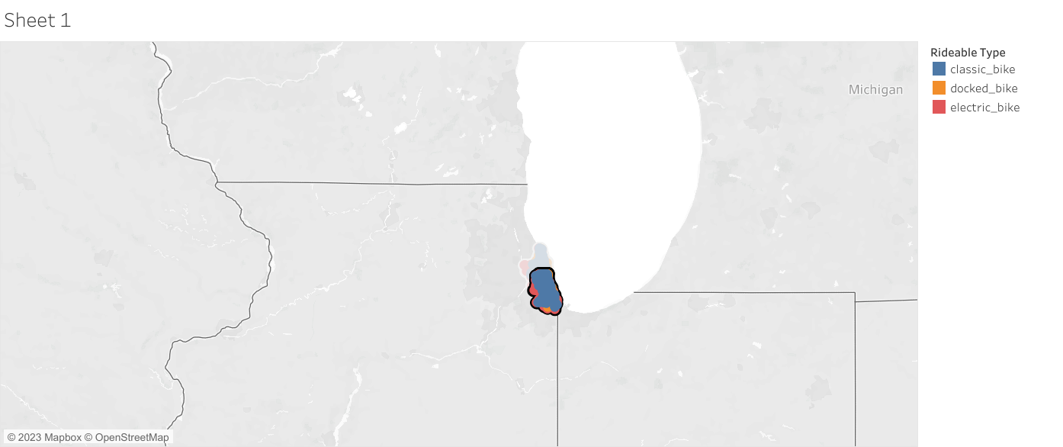
Map of the Bike Stations
Chicago

Slide 11
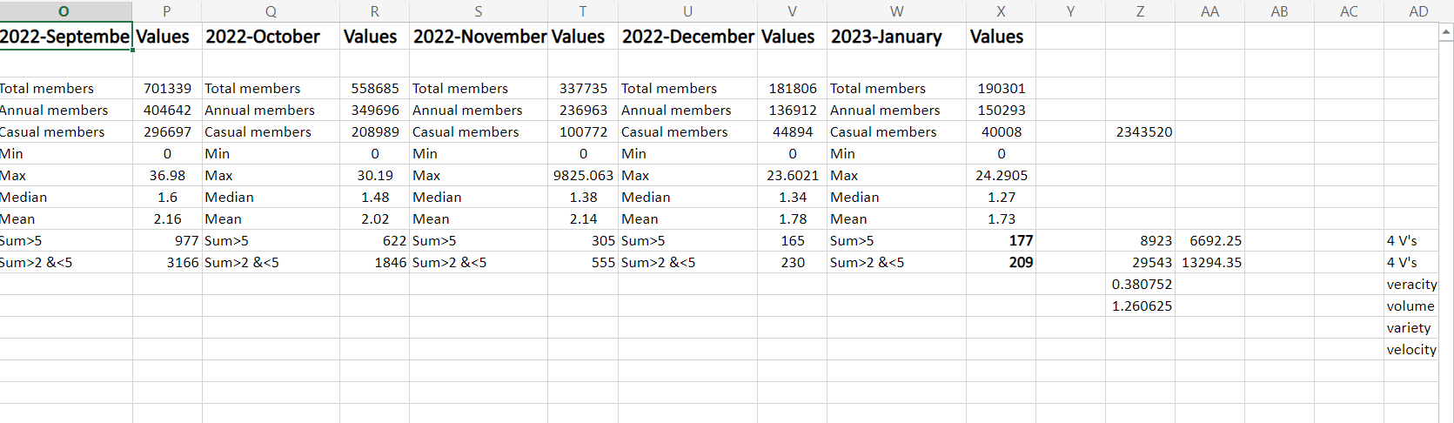
Excel Summary

Slide 12
05
Decision making

Slide 13
Based on the observation we came to the conclusion that it will be profitable to engage digital media/social media influencers to actively campaign for the promotion.
On the overall we project that at least 30-40% of the casual bike riders can be converted to annual memberships/subscription

Slide 14
06
Portfolio

Slide 15
To check more details about the project you can check out my portfolio

Slide 16
Thank You

